Slide 1
Database Systems (CSF212) Lecture – 17

Slide 2
Relational Database Design

Slide 3
Relational Database Design
Features of Good Relational Design
Atomic Domains and First Normal Form
Decomposition Using Functional Dependencies
Functional Dependency Theory
Algorithms for Functional Dependencies
Decomposition Using Multi-valued Dependencies
More Normal Form
Database-Design Process
Modeling Temporal Data

Slide 4
Features of Good Relational Designs
Undesirable properties that a bad database design may have:
Repetition of information
Inability to represent certain information
Loss of information
branch(branch-name, assets, branch-city)
borrow(branch_name, loan-number, customer-name, amount)

Slide 5
Features of Good Relational Designs
Repetition of information
branch
branch-name | assets | branch-city
Downtown | 9000 | Brooklyn
Redwood | 10000 | Palo Alto
Perryridge | 1000 | Horseneck
Mianus | 4000 | Horseneck
Round Hill | 80000 | Horseneck
Brighton | 7100 | Brooklyn
borrow
branch-name | LN | CN | AMT
Downtown | 17 | jones | 1000
Redwood | 23 | Smith | 2000
Perry ridge | 15 | Hayes | 1500
Downtown | 14 | Jackson | 1500
Mianus | 93 | Curry | 500
Roundhill | 11 | Turner | 900
Perryridge | 25 | Glenn | 2500
Brighton | 10 | Brooks | 2200

Slide 6
Features of Good Relational Designs
Repetition of information
branch-borrow
branch-name | assets | branch-city | LN | CN | AMT
Downtown | 9000 | Brooklyn | 17 | jones | 1000
Redwood | 10000 | Palo Alto | 23 | Smith | 2000
Perryridge | 1000 | Horseneck | 15 | Hayes | 1500
Mianus | 4000 | Horseneck | 93 | Curry | 500
Round Hill | 80000 | Horseneck | 11 | Turner | 900
Perryridge | 1000 | Horseneck | 25 | Glenn | 2500
Brighton | 7100 | Brooklyn | 10 | Brooks | 2200

Slide 7
Features of Good Relational Designs
Add a new loan (Perryridge, 31, Turner, 500) to both the designs
borrow
BN | LN | CN | AMT
Downtown | 17 | jones | 1000
Redwood | 23 | Smith | 2000
Perry ridge | 15 | Hayes | 1500
Downtown | 14 | Jackson | 1500
Mianus | 93 | Curry | 500
Roundhill | 11 | Turner | 900
Perryridge | 25 | Glenn | 2500
Brighton | 10 | Brooks | 2200
Perryridge | 31 | Turner | 500

Slide 8
Features of Good Relational Designs
Addition of new tuple leads to repetition of information
branch-borrow
branch-name | assets | branch-city | LN | CN | AMT
Downtown | 9000 | Brooklyn | 17 | jones | 1000
Redwood | 10000 | Palo Alto | 23 | Smith | 2000
Perryridge | 1000 | Horseneck | 15 | Hayes | 1500
Mianus | 4000 | Horseneck | 93 | Curry | 500
Round Hill | 80000 | Horseneck | 11 | Turner | 900
Perryridge | 1000 | Horseneck | 25 | Glenn | 2500
Brighton | 7100 | Brooklyn | 10 | Brooks | 2200
Perryridge | 1000 | Horseneck | 31 | Turner | 500

Slide 9
Features of Good Relational Designs
Why repetition is undesirable?
Waste of space
Causes difficulty in updating a database
Modification anomalies
If Perryridge moves from Horseneck to Newtown
Deletion anomalies
If the details of the customer who happens to be the last borrower from a branch is deleted, then the information about the branch is also lost

Slide 10
Features of Good Relational Designs
Why repetition is undesirable?
Certain information cannot be represented
Cannot store information about a branch if no loans exist (insertion anomalies)
Can use null values, but they are difficult to handle

Slide 11
Features of Good Relational Designs
Is having smaller schema a solution?
borrow
BN | LN | CN | AMT
Downtown | 17 | jones | 1000
Perry ridge | 15 | Hayes | 1500
Downtown | 14 | Jackson | 1500
loan
BN | LN | AMT
Downtown | 17 | 1000
Perry ridge | 15 | 1500
Downtown | 14 | 1500
amount
CN | AMT
jones | 1000
Hayes | 1500
Jackson | 1500

Slide 12
Features of Good Relational Designs
Is having smaller schema a solution?
loan
BN | LN | AMT
Downtown | 17 | 1000
Perry ridge | 15 | 1500
Downtown | 14 | 1500
amount
CN | AMT
Jones | 1000
Hayes | 1500
Jackson | 1500
loan-amount
BN | LN | CN | AMT
Downtown | 17 | jones | 1000
Perry ridge | 15 | Hayes | 1500
Perryridge | 15 | Jackson | 1500
Downtown | 14 | Hayes | 1500
Downtown | 14 | Jackson | 1500

Slide 13
Features of Good Relational Designs
Although the resulting relation has more tuples, it contains less information
For example, we cannot find which customers are borrowers from which branch
∏_{BN} (σ_{CN=“Jackson”} loan-amount)
loan-amount
BN | LN | CN | AMT
Perryridge | 15 | Jackson | 1500
Downtown | 14 | Jackson | 1500
incorrect
information

Slide 14
Features of Good Relational Designs
Such decompositions are called lossy-decomposition or lossy-join decomposition
Lossless-join decomposition: A decomposition that is not a lossy-join decomposition.

Slide 15
Example of Lossless-Join Decomposition
Decomposition of R = (A, B, C) into R₁ = (A, B) and R₂ = (B, C)
A
B
C
A
B
B
C
α
β
1
2
A
B
α
β
1
2
1
2
A
B
r
r₁ ₌ ∏_{A,B}(r)
r₂ ₌ ∏_{B,C}(r)
A
B
C
∏_{A,B} (r) ∏_{B, C} (r)
α
β
1
2
A
B
In general decomposition is lossless provided certain functional dependencies hold

Slide 16
Goal — Devise a Theory for the Following
Decide whether a particular relation R is in “good” form.
In the case that a relation R is not in “good” form, decompose it into a set of relations {R₁, R₂, ..., R_{n}} such that
each relation is in good form
the decomposition is a lossless-join decomposition
Our theory is based on:
functional dependencies
multi-valued dependencies

Slide 17
Summary of Features of Good Relational Designs
Free from various forms of anomalies
Causes very less wastage of storage spaces due to NULLS
Does not generate spurious data during joins

Slide 18
Normalization
Normalization: Process of analyzing a relational schema based on their functional dependencies and primary keys to achieve the desirable properties of
Minimizing redundancy
Minimizing anomalies
Schemas that do not satisfy “normal form properties” are decomposed into smaller relational schemas that satisfies these properties
NF of a relation: Refers to the highest NF condition that it meets

Slide 19
Normalization
Normalization is carried out in practice so that the resulting designs are of high quality and meet the desirable properties
The practical utility of these normal forms becomes questionable when the constraints on which they are based are hard to understand or to detect
The database designers need not normalize to the highest possible normal form. (usually up to 3NF, BCNF or 4NF)
Denormalization: the process of storing the join of higher normal form relations as a base relation—which is in a lower normal form

Slide 20
Normalization
Normalization through decomposition must also confirm the existence of following additional properties that the relational schema should possess:
Lossless join – Guarantees that the spurious tuple generation problem does not occur
Dependency preservation – Although not mandatory, each functional dependency should hold after decomposition

Slide 21
First Normal Form (1NF)
Domain is atomic if its elements are considered to be indivisible units
Examples of non-atomic domains:
Set of names, composite attributes
Identification numbers like CS101 that can be broken up into parts
A relational schema R is in first normal form if the domains of all attributes of R are atomic
Non-atomic values complicate storage and encourage redundant (repeated) storage of data
Example: Set of accounts stored with each customer, and set of owners stored with each account

Slide 22
First Normal Form
customer
CN | CID | C_ADDR
Jones | 1 | ABC street, Downtown
Jones | 2 | XYZ street, Perryridge
loan
BN | LN | CID
Downtown | 17, 20 | 1
Perry ridge | 15 | 2
customer
CN | CID | C_Street | C_City
Jones | 1 | ABC | Downtown
Jones | 2 | XYZ | Perryridge
loan
BN | LN | CN
Downtown | 17 | 1
Downtown | 20 | 1
Perryridge | 15 | 2
New attributes are added
New tuples are added

Slide 23
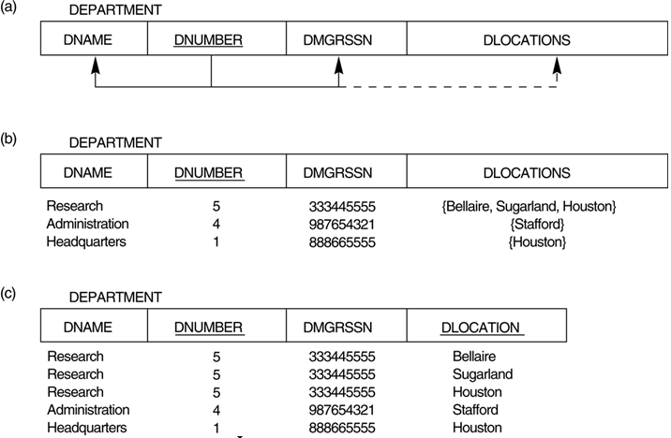
First Normal Form

Slide 24
Decomposition Using Functional Dependencies
There are usually a variety of constraints (rules) on the data in the real world.
Students and instructors are uniquely identified by their ID
Each student and instructor has only one name, etc.
Legal instance of a relation: An instance of a relation that satisfies all real-world constraints
Legal instance of a database: Where all the relation instances are legal instances
Constraints are represented formally as keys (super keys, candidate keys and primary keys), or as functional dependencies

Slide 25
Functional Dependency
Functional dependencies (FDs) are used to specify formal measures of the "goodness" of relational designs
FDs and keys are used to define normal forms for relations
FDs are constraints that are derived from the meaning and interrelationships of the data attributes
A set of attributes X functionally determines a set of attributes Y if the value of X determines a unique value for Y

Slide 26
Functional Dependencies
Notation used for representing database elements:
Greek letters: For sets of attributes (for example, )
r (R): Schema is for relation r, where R denotes the set of attributes. Just R is used
R: When the relation name does not matter
K : A set of attributes that forms the Superkey
t[]: Values in t on attributes in set 
Lower case names: For relations (for example, instructor). In Definitions and algorithms, single letters, like r is used

Slide 27
Functional Dependencies
Consider a relation schema r(R), and let α ⊆ R and β ⊆ R:
Given an instance of r (R), we say that the instance satisfies the functional dependency α → β, if for all pairs of tuples t₁, t₂ ∈ r , if t₁[α] = t₂ [α] ⇒ t₁[β ] = t₂ [β ]
We say that the functional dependency α → β holds on schema r (R) if, in every legal instance of r (R) it satisfies the functional dependency
Example: Consider r(A,B) with the following instance of r:
A | B
1 | 4
1 | 5
2 | 7
On this instance, A → B does NOT hold, but B → A does hold. So, we can say B functionally determines A

Slide 28
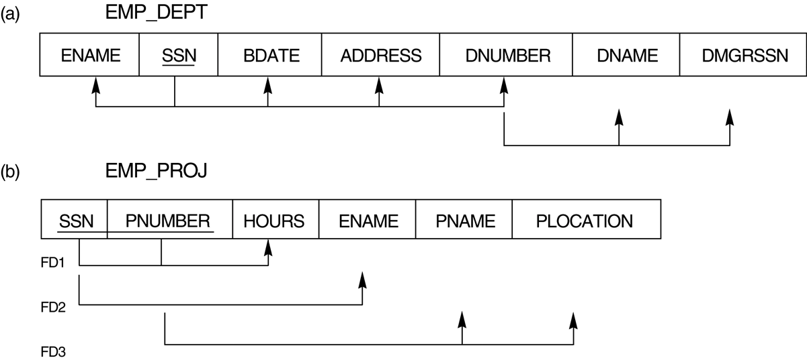
Functional Dependencies
FD is a property of the attributes in the schema R
The constraint must hold on every relation instance r(R)
If K is a key of R, then K functionally determines all attributes in R

Slide 29
Use of Functional Dependencies
Specify constraints on the set of legal relations
To define keys of a database
K is a superkey for relation schema R if and only if K → R
K is a candidate key for R if and only if
K → R
For no α ⊂ K, α → R

Slide 30
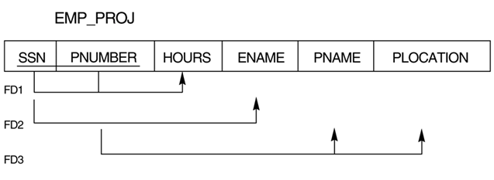
Functional Dependencies
A functional dependency α → β is trivial if β ⊆ α
Trivial FD’s:
SSN, PNUMBER → SSN, PNUMBER
SSN, PNUMBER → PNUMBER
SSN, PNUMBER → SSN
SSN → SSN
PNUMBER → PNUMBER

Slide 31
Definitions
Uses the concepts of Partial FDs and Candidate key
Prime attribute - Attribute that is member of the candidate key. Other attributes are called as non-prime key
Full functional dependency - A FD Y → Z where removal of any attribute from Y means the FD does not hold any more
Partial dependency: Partial Dependency occurs when a non-prime attribute is functionally dependent on part of a candidate key
They introduce redundancy in the relation

Slide 32
Example
Full dependencies
{SSN, PNUMBER} → HOURS
Partial dependencies
{SSN, PNUMBER} → ENAME
{SSN, PNUMBER} → PNAME
{SSN, PNUMBER} → PLOCATION

Slide 33
Second Normal Form
A relation schema R is in second normal form (2NF) if:
It is in 1NF
Every non-prime attribute A in R is fully functionally dependent on the candidate key
2NF Decomposition:
Remove all non prime attributes which are partially dependent on the primary key from the original relation
Create a new relation in which non prime attributes are associated only with the part of the primary key on which they are fully functionally dependent

Slide 34
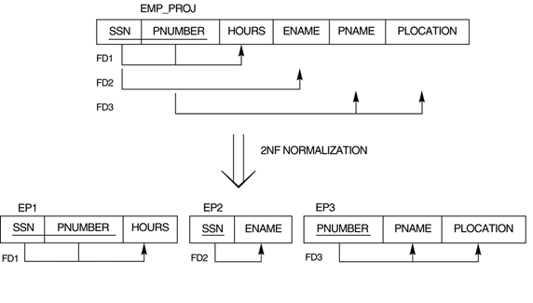

Slide 35
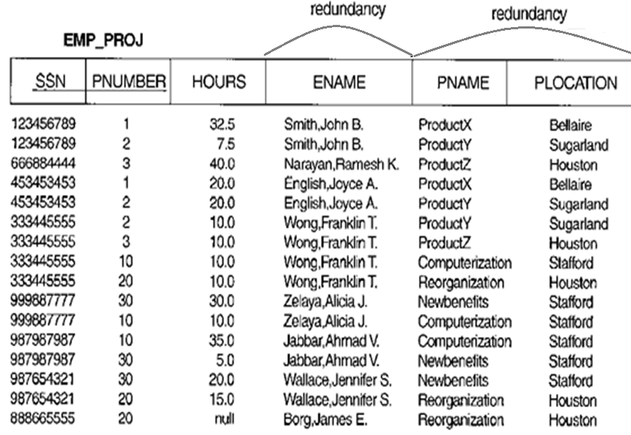
Need for 2NF
✓
✓
✓
✓
✓
✓
✓
✓
✓
✓
✓
✓
✓
✓

Slide 36
Second Normal Form
banker(c_id, agent_no, br_code)
Constraints:
A agent can work for only one branch
A agent can serve many customers
agent_no → br_code
br_code, c_id → agent_no
candidate key
= {{c_id, agent_no}, {c_id, br_code}}
Non prime attribute
- No
Relation is in 2NF
- Yes
Redundancy ?
- Yes

Slide 37
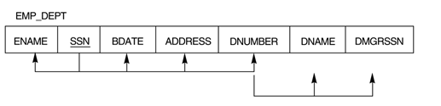
Third Normal Form
Transitive functional dependency: A functional dependency X → Z that can be derived from two FDs X → Y and Y → Z
SSN → DNUMBER, DNUMBER → DMGRSSN ➔
SSN → DMGRSSN (transitive FD)

Slide 38
Third Normal Form
A relation schema R is in third normal form (3NF) if:
It is in 2NF
No non-prime attribute A in R is transitively dependent on the primary key
In X → Y and Y → Z, with X as the primary key, we consider this a problem only if Y is not a candidate key
3NF decomposition:
Remove all non key attribute(s) which are functionally dependent on other non key attribute(s) from the original relation
Create a new relation that includes the non key attribute(s) that functionally determines(s) other non-key attribute(s)

Slide 39
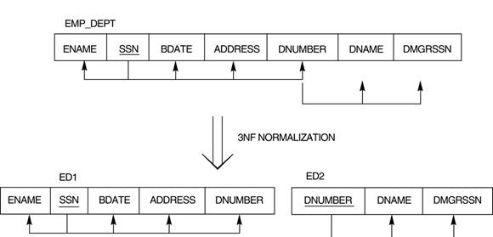
Third Normal Form

Slide 40
Third Normal Form
banker(c_id, agent_no, br_code)
Constraints:
A agent can work for only one branch
A agent can serve many customers
agent_no → br_code
br_code, c_id → agent_no
candidate key
= {{c_id, agent_no}, {c_id, br_code}}
Non prime attribute
- No
Relation is in 3NF
- Yes
Redundancy ?
- Yes

Slide 41
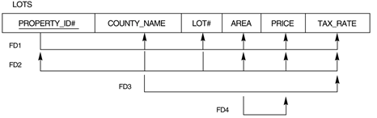
Practice problem

Slide 42
